Slide 1

A Study On Pollution Caused By Small Scale Automobile Industries/ Workshops
CLE 2018 – INDUSTRIAL WASTE TREATMENT AND DISPOSAL
add text
J-Component
( Review-1 )
PRESENTED BY :
Pavithra P - 20BCL0080
Priyadarshini K - 20BCL0110
Nishu Kumari Yadav - 20BCL0143
Siddharth Yadav - 20BCL0127
( School of Civil Engineering )
GUIDED BY:
Prof. Shantha Kumar S Professor Grade 2
Centre for Clean Environment
Vellore Institute of Technology (VIT)
Vellore, Tamil Nadu, India

Slide 2
Introduction
Small scale automobile industries/workshops are referred to as those industries in which the process of manufacturing, production and servicing are done on a small or micro scale. In these industries, the manufacturing of goods and rendering of services are done with the help of small machines and very limited manpower. For instance; Spare parts manufacturing industry, tires manufacturing industry, automobiles workshops and repair shops, etc.
Due to increase in automobiles, urbanization and vehicle ownership there is increase in the number of automobiles industries/workshops. However, people have neglected its contribution in exponential increase in pollution caused by these industries during manufacture and maintenance process.

Slide 3
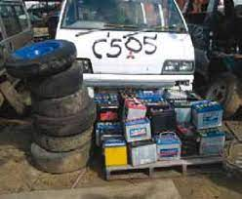
Types of Industrial Wastes from Small Automobile industry
There are four different types of industrial wastes:
Solid waste: Used tires, plastic packages, dead batteries, rubbers, glasses, scrap metals,
unserviceable parts.
Liquid waste: litter, oil, grease, sediments, debris, wash-water, flammable liquids such as paint.
Toxic waste: Volatile organic compounds, refrigerants, LPG, diisocyanates, fuel vapours, smoke.

Slide 4
Objectives:
To collect sample from small automobile industries/workshops and analyze the major pollutants through data sampling, studies and experimental analysis.
To find out the impacts due to the wastes produced by small scale automobiles industries/workshops.
To discuss the treatment process followed in small scale automobiles industries.

Slide 5

METHODOLOGY
Problems faced due to discharge of untreated wastewater and water usage
Things we are going to cover in this topic
Objectives
Issues
01.
02.
03.
04.
05.
Experimental
Analysis
Solution and conclusion
Introduction
Brief intro and discussing the type of pollutants released
Experiments like Sulphur test or Benzene test to confirm the presence of chemicals
Alternative ways to reduce pollution and suggesting new way

Slide 6
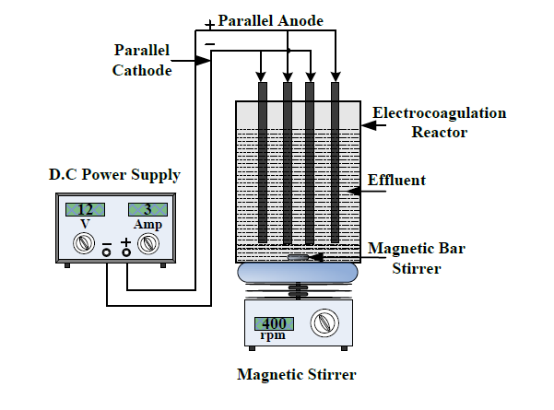
S.No | Author name & Publishing Year | Journal name | Paper Title | Methodology | Important Findings
1. | Ng Seow Chian1, A.H. Nor Aziati Sha’ri Mohd Yusof | IEEE Xplore | Green Manufacturing Performance Measure for Automobile Manufacturers | Manufacturing Sector are Major Contributors to Pollution. So, Malaysian government introduces several policies and incentives to urge green operations various industry. Malaysia is one among Top 3 Automobile Markets. The main objective of this study is to identify factors that has positive effect towards green manufacturing performance of automobile industry . National Automobile Policy (NAP) 2014- aims to protect environment and efficiency at the same time. | By extensive literature review, ten factors were identified, and it was further investigated to establish a green manufacturing evaluation model. Additionally, insight acquired may assist government agencies to outline green manufacturing policies and guideline. Results of the study is expected to be essential for Malaysia automobile industry to implement green manufacturing operations more effectively and efficiently.
2. | Neha Pandey, Chandrakant Thakur | International Journal of Trend in Research and Development | Treatment of Automobile Wastewater by Electro-coagulation | The study was conducted in the Raipur city. Objective of the present study was to survey the relevance of electrocoagulation as a conceivable method for treatment of automobile service station wastewater. Study on three essential process parameters like CD, pH and initial COD concentration, had been done and COD removal has taken as responses. | Electrocoagulation (EC) has been successfully used for treatment of a variety of industries. Various factors influence EC process electrolysis time, current density (CD) and wastewater characteristics. Optimization of these factors is important to diminish power utilization and general treatment cost. EC process was found effective treatment method to reduce COD. The COD reduction was found to increase with increase in current density.

Slide 7
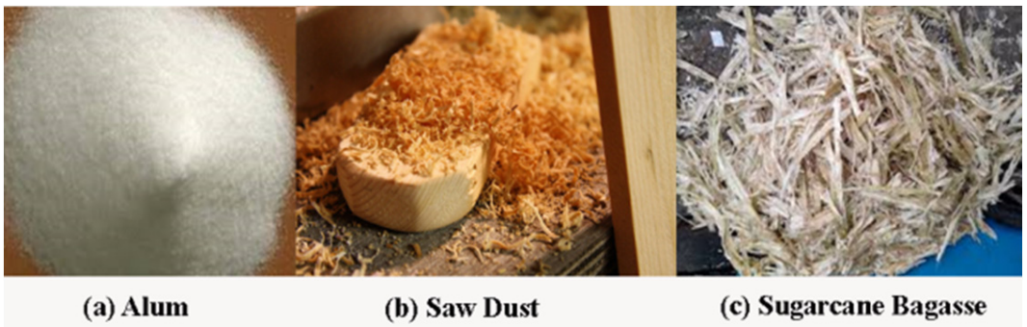
S.No | Author Name and Publishing Year | Journal Name | Paper Title | Methodology | Important Findings
3. | M.N. Asha, K.S. Chandan , H. P. Harish , S. Nikhileswar Reddy , K. S. Sharath , G. Mini Liza | International Conference on Solid Waste Management, 5IconSWM | Recycling Of Wastewater Collected From Automobile Service Station | This paper compares the effectiveness of chemical and physical methods in treating the wash water collected from automobile service stations. Wash water was collected from two service stations in the city of Bangalore, and the effluent was characterized for different parameters such as pH, turbidity, conductivity, total solids, oil and grease, COD (chemical oxygen demand), BOD (biological oxygen demand), chlorides, sulphate and total hardness. For chemical treatment, alum was used and locally available natural materials such as saw dust and sugarcane bagasse were used for physical treatment. | The sorption capacity of any material is dependent on its porosity, surface area and height of filter bed. Higher the alum concentration, higher was the percentage removal of oil and grease and COD. Use of low-cost bio adsorbent could be fruitfully used for the removal of COD and Oil & grease over a wide range of concentrations. For natural methods, higher the specific area, higher was the percentage removal. Therefore, saw dust was more effective than sugarcane bagasse.

Slide 8
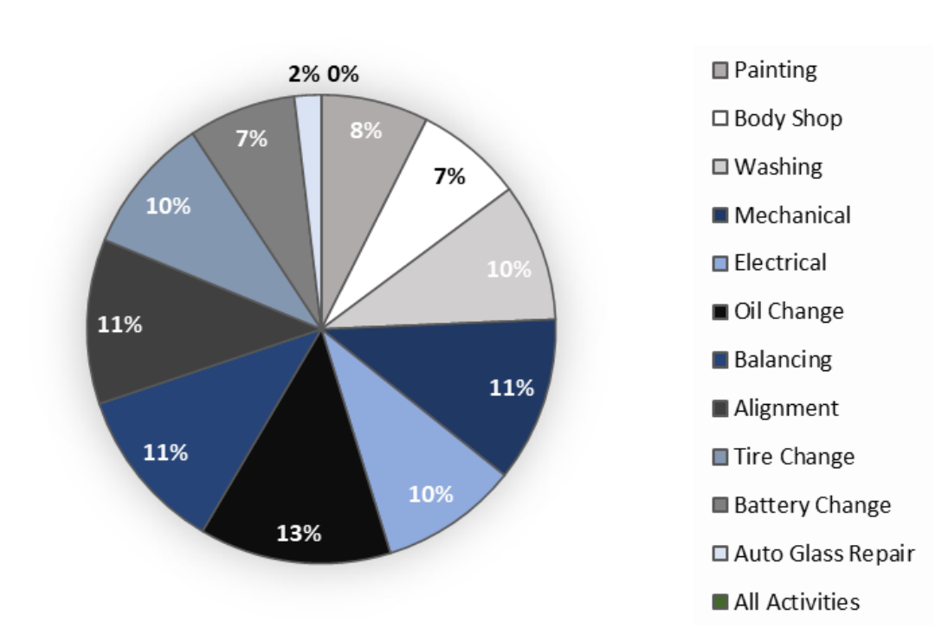
S.No | Author Name and Publishing Year | Journal Name | Paper Title | Methodology | Important Findings
4. | Nathalia Torres Dutra , Cristiane Pimentel Victório (2020) | Acta Scientiae et Technicae, Vol 8, number 2, | Automobile repair shops have a negative impact on the environment | This work aimed to identify problems in car repair shops in relation to current environmental regulations to provide compliance guidelines. To accomplish this, they carried out a data survey in car garages for small vehicles with low polluting potential in the City of Rio de Janeiro – RJ (Brazil). By evaluating physical facilities, environmental control mechanisms and environmental management of waste, or the lack thereof, our results shed light on the key sources of pollution created by these establishments and how such pollution can be controlled by compliance with legislation applicable to this sector. | Among the services performed by the vehicle repair shops, it appears that oil change was a significant activity in that it was provided by 50% of the analyzed shops. Vehicle repair shops are potentially polluting establishments, in particular deposition of solid residues, effluents and air pollutants generated in the performance of their normal activities. Correspondingly, the main irregularity involved the improper storage of dangerous products or waste without the exercise of proper environmental control.

Slide 9
REFERENCES
Publishing Year | Author Name | Paper Title | Link
2017 | Ng Seow Chian1, A.H. Nor Aziati Sha’ri Mohd Yusof | Green Manufacturing Performance Measure for Automobile Manufacturer | https://www.sciencedirect.com/science/article/pii/S1878029616300986
2017 | Neha Pandey, Chandrakant Thakur | Treatment of Automobile Wastewater by Electro-coagulation | https://www.researchgate.net/publication/331472121_Green_Manufacturing_Performance_Measure_for_Automobile_Manufacturers
2016 | M.N. Asha, K.S. Chandan , H. P. Harish , S. Nikhileswar Reddy , K. S. Sharath , G. Mini Liza | Recycling Of Wastewater Collected From Automobile Service Station | https://www.researchgate.net/publication/348755721_Automobile_repair_shops_have_a_negative_impact_on_the_environment
2020 | Nathalia Torres Dutra , Cristiane Pimentel Victório | Automobile repair shops have a negative impact on the environment | https://www.researchgate.net/publication/341787646_Treatment_of_Automobile_Wastewater_by_Electrocoagulation

Slide 10
A Study On Pollution Caused By Small Scale Automobile Industries/ Workshops
CLE 2018 – INDUSTRIAL WASTE TREATMENT AND DISPOSAL
add text
J-Component
( Review-2 )
PRESENTED BY :
Pavithra P - 20BCL0080
Priyadarshini K - 20BCL0110
Nishu Kumari Yadav - 20BCL0143
Siddharth Yadav - 20BCL0127
( School of Civil Engineering )
GUIDED BY:
Prof. Shantha Kumar S Professor Grade 2
Centre for Clean Environment
Vellore Institute of Technology (VIT)
Vellore, Tamil Nadu, India

Slide 11
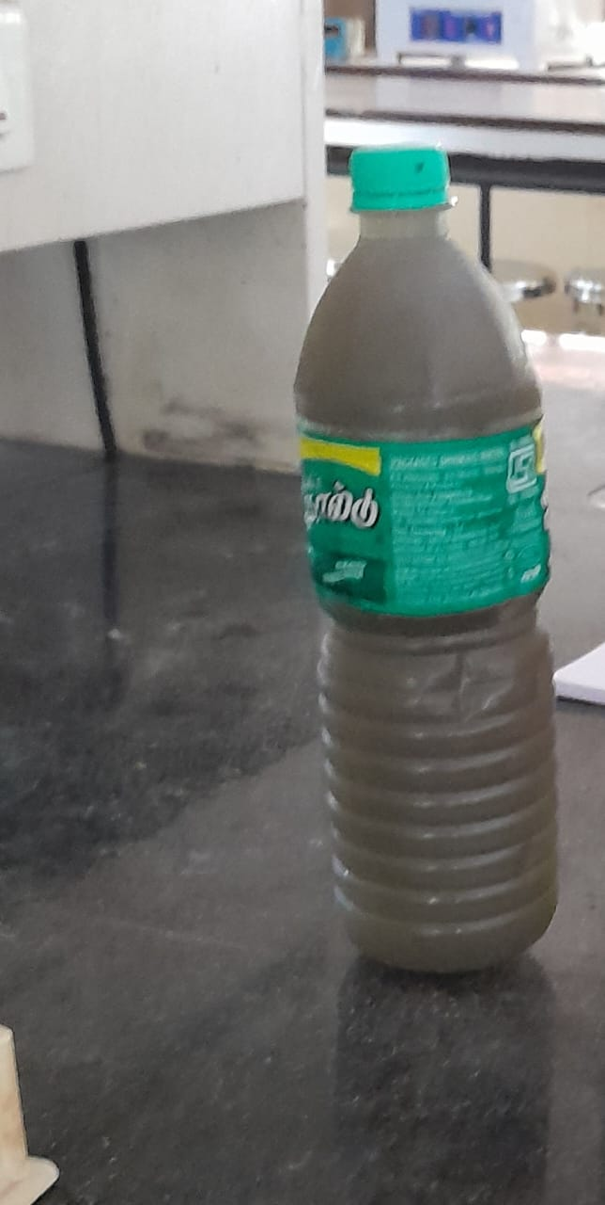
Sample Collection
The sample was collected in the Arcot, Ranipet District from nearby authorized vehicle service stations where, washing, servicing, and maintenance of vehicles are done.
Though all maintenance and repair works were done in the service stations, the primary contribution for the automobile effluent was vehicle washing.
Service station was indulged in both 2-wheeler and 4-wheeler servicing.
No separate sump systems were provided in the service stations; instead they were directly linked to drainage systems.
And the sample was characterized for various parameters like pH, Total solids, Fixed solids and Volatile Solids, as well as chemical oxygen demand (COD) etc.
Automobile Sample

Slide 12
Experiments conducted in Lab
Potential of Hydrogen (pH)
Chemical Oxygen Demand (COD)
Oil and grease
Total Dissolved Solids

Slide 13
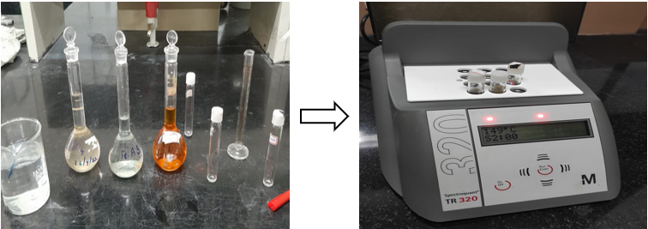
COD Test
Operating Principle:
The organic Matter Present in Industrial Wastewater oxidized completely by K2Cr2O7 in the presence of H2SO4 to produce CO2 + H2O.
The dichromate consumed gives the O2 required for oxidation of organic matter.
Preparation of reagents:
Standard ferrous ammonium sulphate 0.1 M: Dissolve 9.8g Mohr’s Salt [Ammonium iron (II) sulfate] in about 100 mL distilled water. Add 5 mL conc. H2SO4, cool and dilute to 250 mL.
Standard potassium dichromate 0.01667 M: Add to about 500 mL distilled water 4.903 g K2Cr2O7, primary standard grade, 167 mL conc. H2SO4 and 33.3 g HgSO4. Dissolve, cool to room temperature and dilute to 1000 mL.
Sulphuric Acid reagent: Add 5 g of Ag2SO4 to 500 mL conc. H2SO4 and keep over night for dissolution.

Slide 14
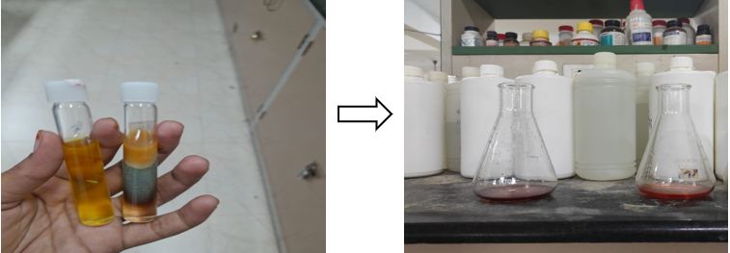
COD Test
Procedure:
Add 2.5 mL Sample + 1.5 mL K2Cr2O7 + 3.5 mL conc. H2SO4 in digestor tubes and Digesting the sample for about 2 hrs.
Result:
Titrate the sample using ferrous ammonium sulphate (FAS) solution as titrant until colour changes from blue-green to reddish brown.

Slide 15
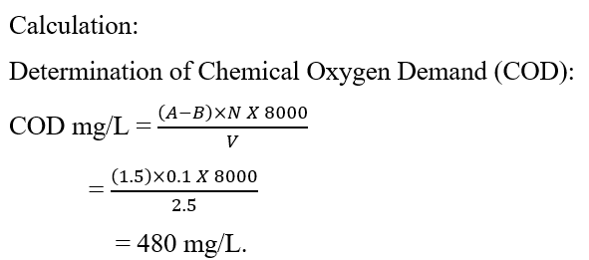
Inference:
According to Central Pollution Control Board. The COD of wastewater should be around 250 mg/L to discharge into Marine coastal areas is. Our Value is 480 mg/L. It exceeds the Limit. So, the water should be treated before discharge into the Marine coastal areas.

Slide 16
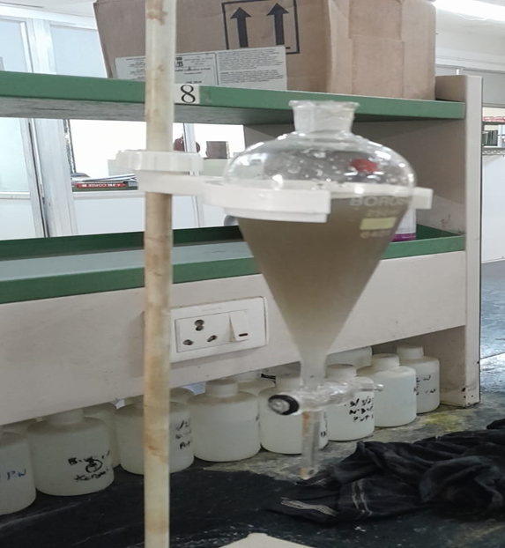
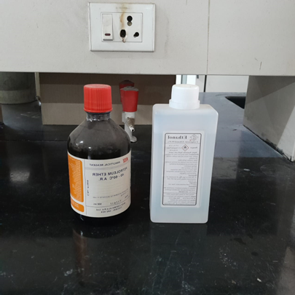
Oil and Grease Test
Operating Principle:
Oil and grease present in the water can be extracted in petroleum ether, which is immiscible in water and can be separated by a separatory funnel. The residue, after evaporation of this petroleum ether will yield the oil and grease.

Slide 17
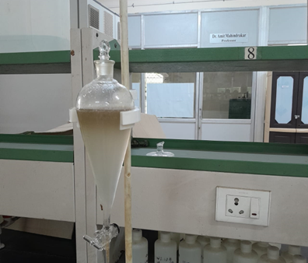
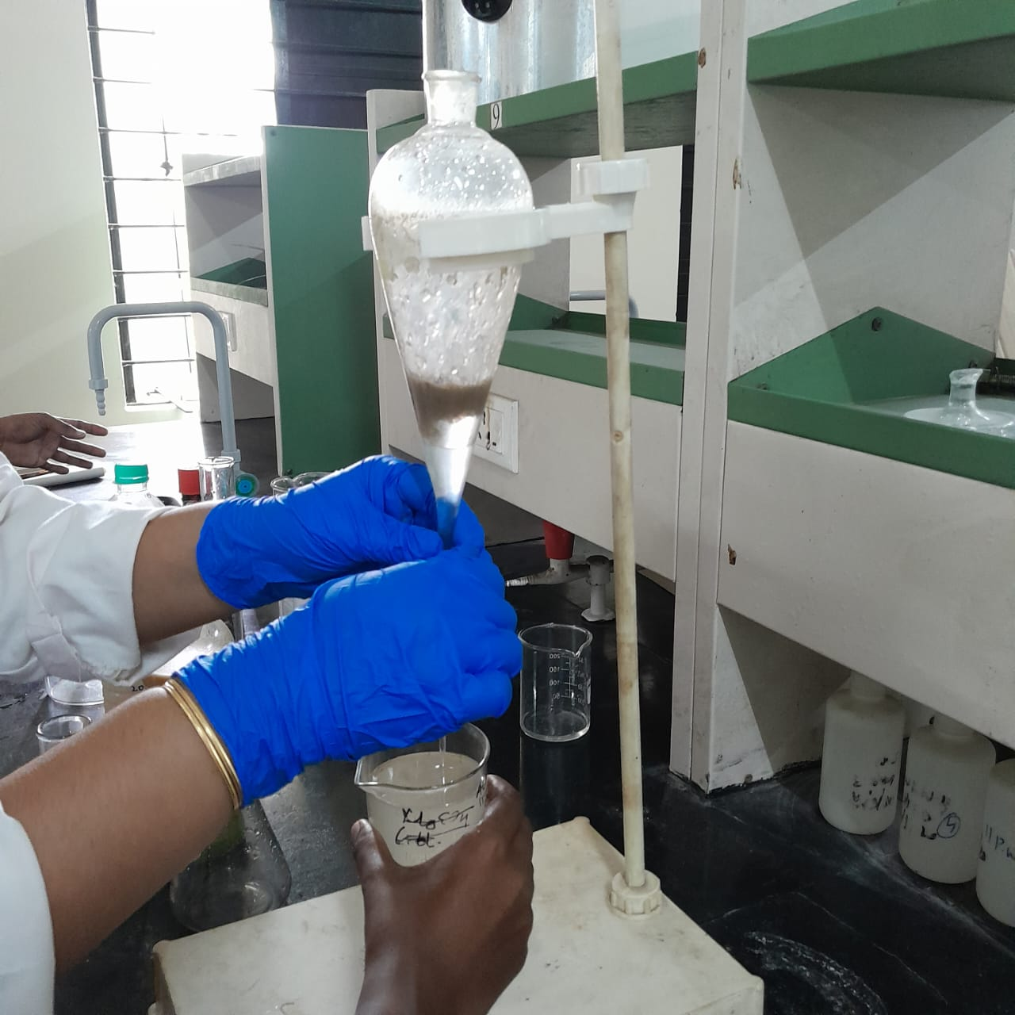
Procedure:
200 to 250 mL of sample +10mL of sulfuric acid +to 50 mL of petroleum ether in separatory funnel.
Shake well, then after sometime it forms two distinct layers.
Discard the lower layer of the sample through separatory funnel with filter paper.
Add little more petroleum ether through the wall of filter paper to remove any residual oil and grease on filter paper.
Now evaporate it on a water bath and get final weight.

Slide 18
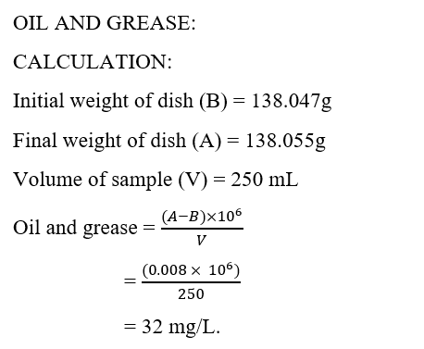
Calculation

Slide 19
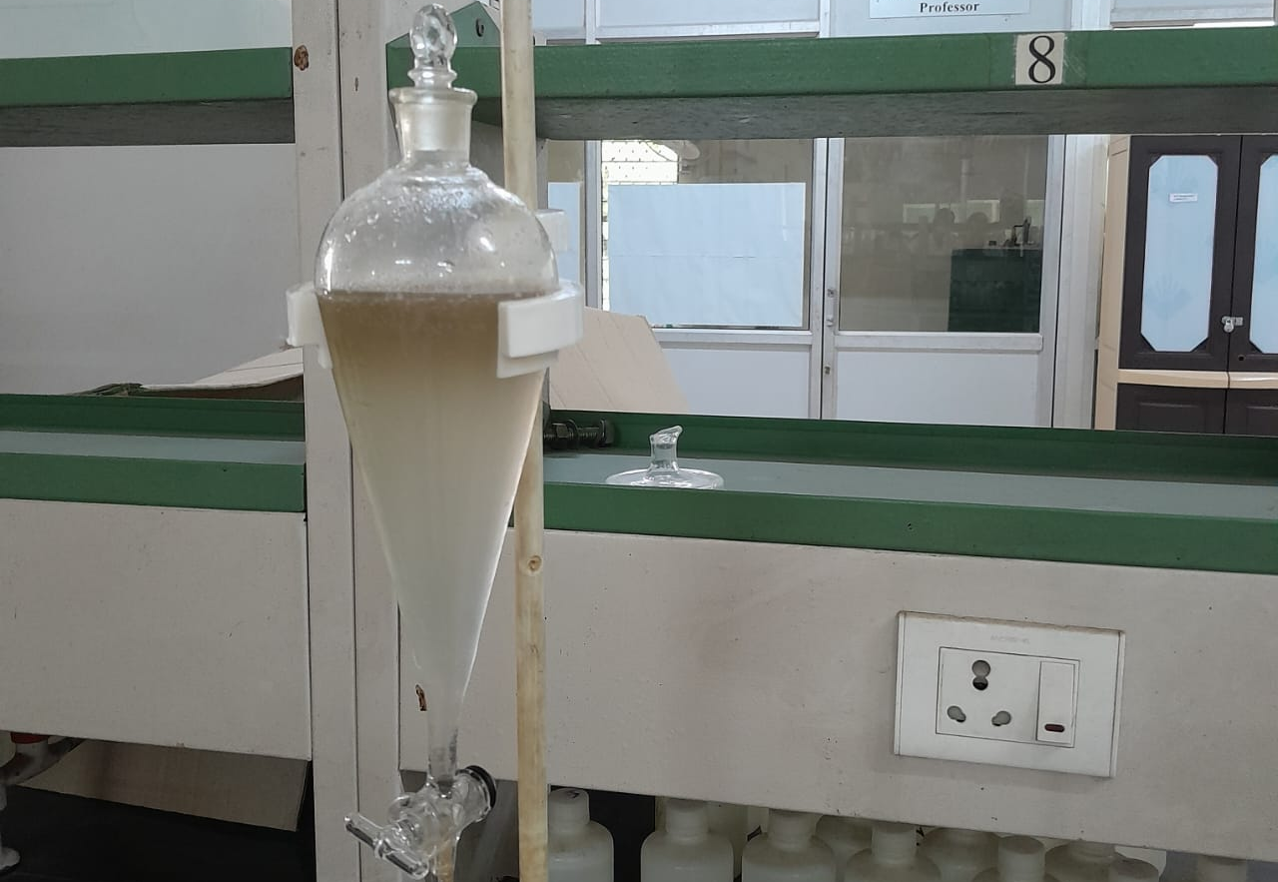
Result:​
The Oil & Grease content in the given water sample = 32mg/L
Inference:​
According to Cental Pollution Control Board. The effluent discharge of Oil and grease into surface water and Marine coastal areas is 20 mg/L. Our Value is 32 mg/L. It exceeds the Limit. So, the water should be treated before discharge into the Marine coastal areas. ​

Slide 20
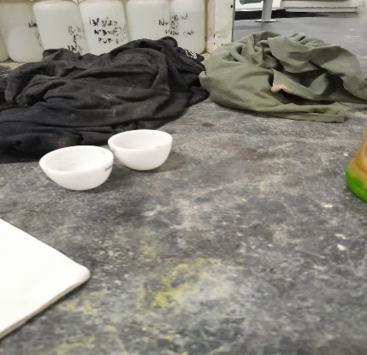
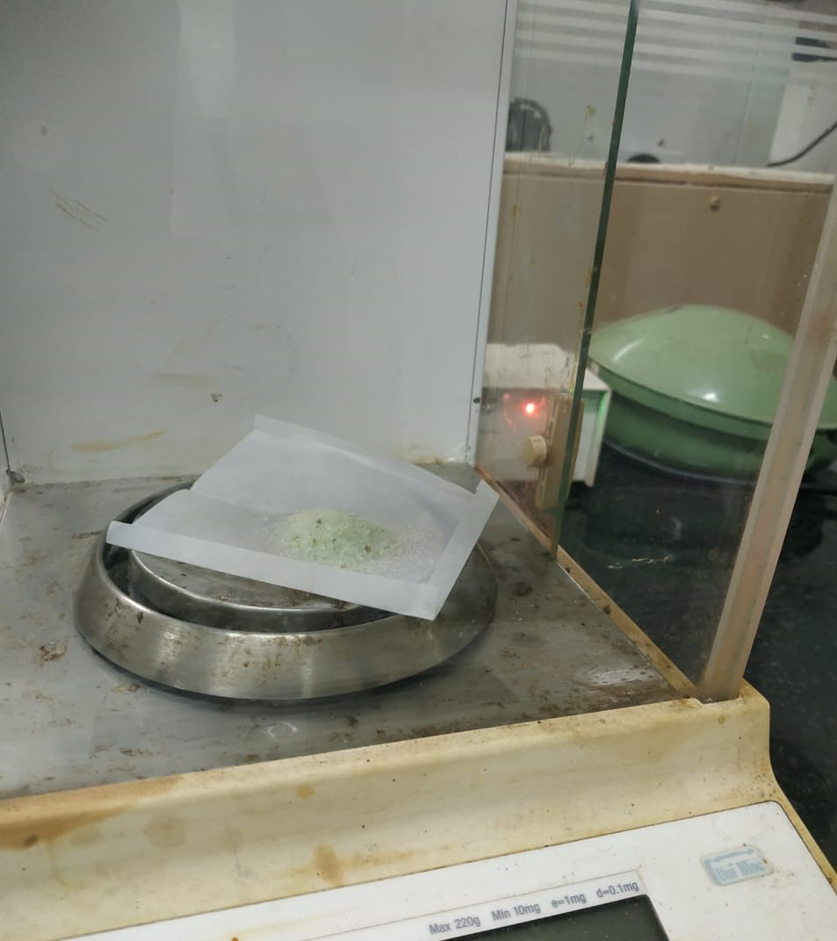
Determination of Solids
Determination of Solid Test
Operating Principle:
Total Solids (TS) is the measure of all kinds of solids i.e. suspended, dissolved and volatile solids. Total solids can be determined as the residue left after evaporation at 103 to 105 degrees of the unfiltered sample.

Slide 21
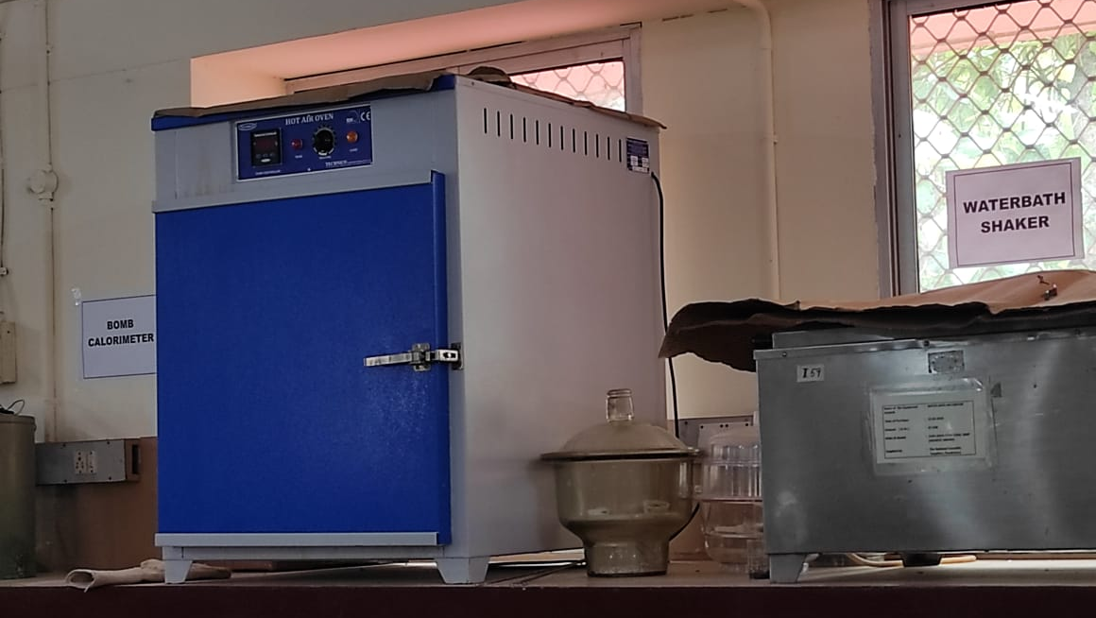
Procedure:
Taken 25 mL of wastewater sample in a thoroughly cleaned and perfectly dried crucible.
Taken the weight of the empty crucible ( W1 g).
Evaporated the water content of the sample at 103°C to 105°C in a hot air oven (may take 4- 6 hours).
After the evaporation, taken out the crucible from oven and placed it in a desiccator and cooled to the room temperature.
Taken the weight of crucible with residue (W2 g).
Placed the same crucible in Muffle furnace at a temperature of 650°C for 30 minutes.
Cooled the crucible and weighed it with the solid residue (W3 g).

Slide 22
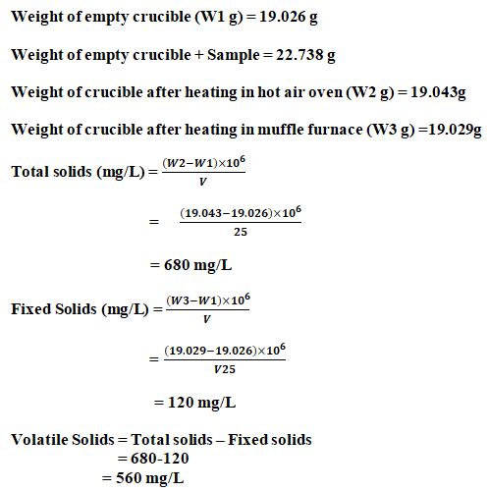
Calculation

Slide 23
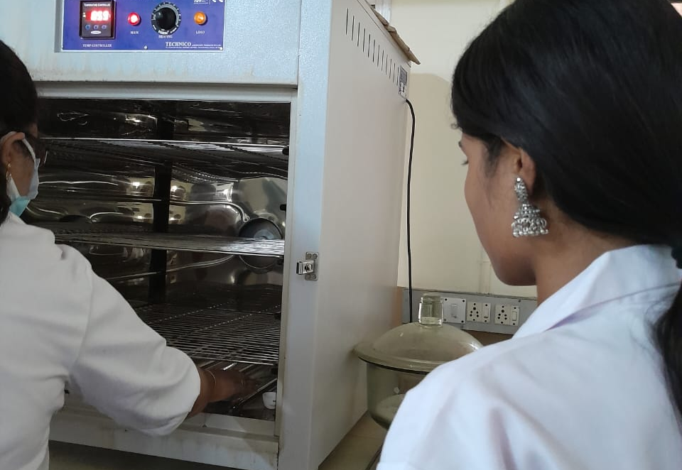
Inference:​
As per IS 10500-2012 the total dissolved solids in drinking water is 500 mg/L under acceptable limit and in absence of alternate resources it ranges up to 2000 mg/L. For the given sample, the total dissolved solid is found to be 680 mg/L. So, it is not suitable for the discharging in the environment without treatment.

Slide 24
Potentiality of Hydrogen (pH) Test
Principle:
The basic principle of electronic pH measurement is the determination of activity of hydrogen ions by potentiometric measurement using a standard sensing electrode (glass-electrode) and a reference electrode (calomel electrode).
Reagents:
Buffer solution of known pH i.e. 4.0, 7.0 & 9.2

Slide 25
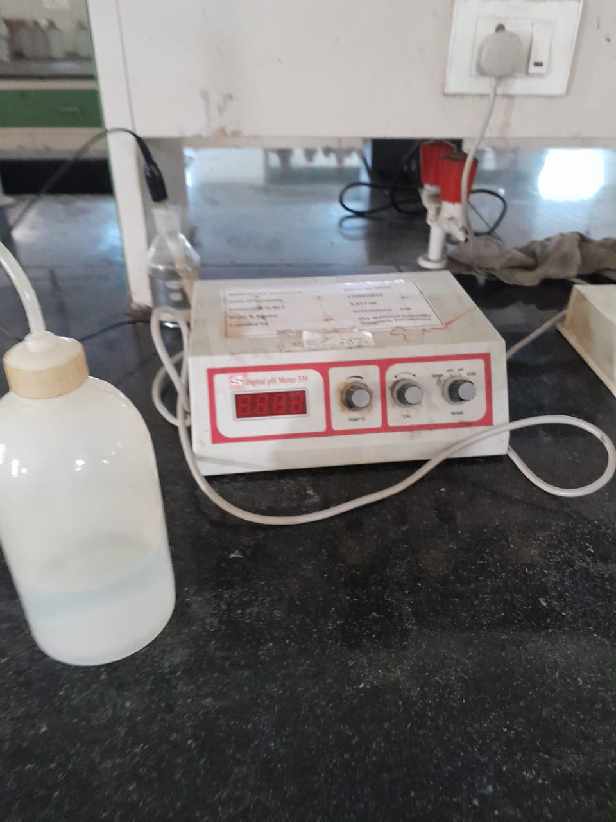
Procedures:
Calibrate the pH meter
After calibration is complete, rinse & dry probe, place a beaker containing the sample on the stir-plate, lower probe, turn on stirrer
Obtain a stable reading & observe the values and record
Rinse the probe when you are finished the measurement
Inference:
The pH of collected water/wastewater samples is 8.5. So, the collected wastewater is alkaline in nature.
Potential of Hydrogen (pH)

Slide 26


